Slide 1
Dijkstra’s Algorithm
Tran, Lancrely
CS 131 Semester Project

Slide 2
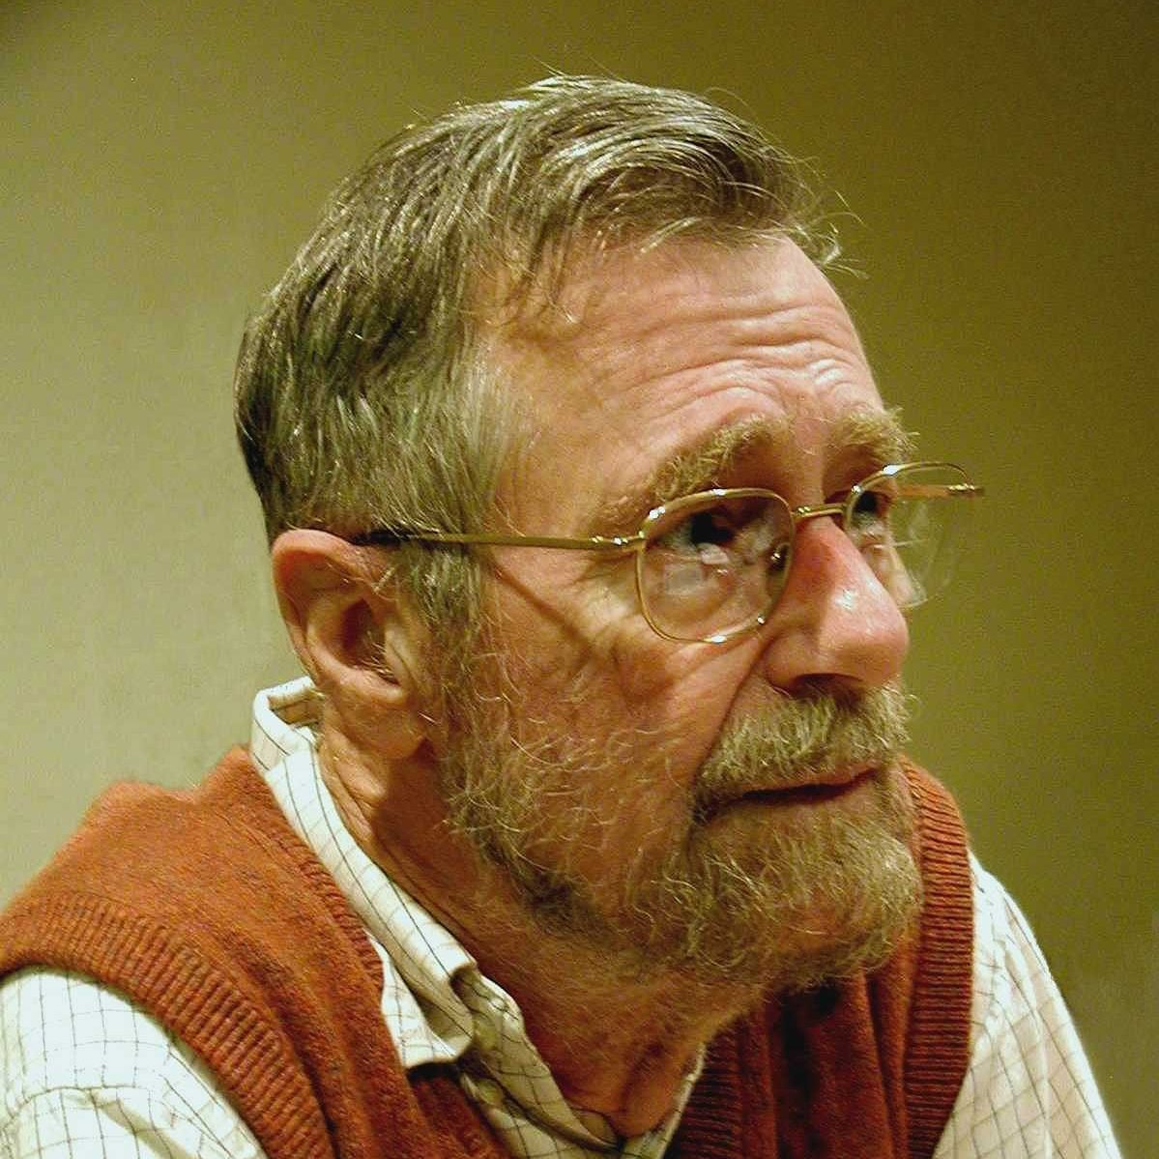
Who is Dijkstra?
Edsger Wybe Dijkstra was born in Rotterdam, Netherlands and studied theoretical physics before deciding to pursue computer science
Received 1974 Harry H. Goode Memorial Award for his contributions in pushing programming to be considered a science and a profession.
Known for the shortest path-algorithm, THE multiprogramming system, Reverse Polish Notation, and Banker’s algorithm, to name a few.
Coined the programming phrase, “2 or more, use a for”
Passed away from cancer in Nuenenm, Netherlands on August 2002

Slide 3
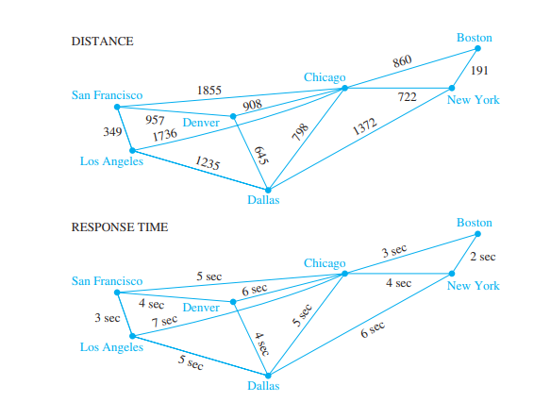
Famous/Common Uses of Dijkstra’s Algorithm
Telephone Networking (frequency, bandwidth)
Flight Agenda
Social Networking Applications (suggesting friends you may know)
IP routing
Designating file servers (Local Area Network)
Robotic Paths (i.e. Drones)
Digital Mapping

Slide 4

How Dijkstra’s Algorithm Works
Utilizes a greedy algorithm to find the shortest path between two nodes in a graph
Has many variations
Begins at the starting vertex and proceeds to undergo various iterations of different paths until it reaches the end vertex
Compares each route taken and calculates the shortest path from beginning vertex to end vertex

Slide 5
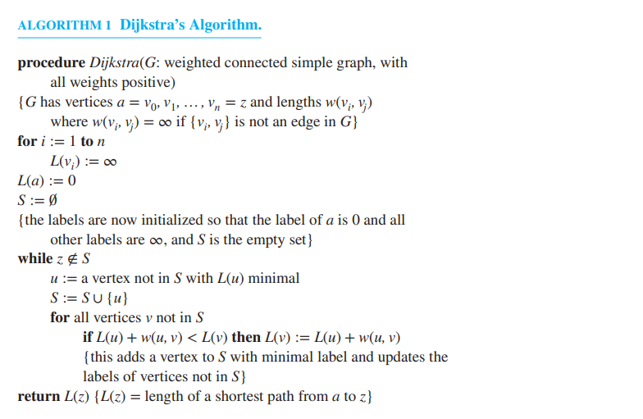
Basis of the Dijkstra Algorithm
The following shows Dijkstra’s Algorithm via our textbook.

Slide 6

Dijkstra’s Algorithm in Google Maps
Dijkstra’s algorithm interests me because I discovered that a variation was used in google’s navigation system
Uses Dijkstra’s Algorithm as a foundation
Implements Depth First Search and Reverse traversal
Takes into account distance, traffic, stoplights, accidents, etc.

Slide 7
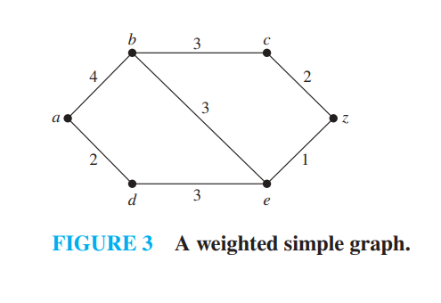
Simple Dijkstra’s Algorithm Example
We want to find the shortest path from point A to point Z
We can find the shortest route from inspection, but ideally, graphs are significantly larger in the real world
Thus, we will use the algorithm.

Slide 8
Continued Example
2 (a, d) < 4 (a, b)
4 (a, b) < 5 (a, d, e)
5 (a, d, e) < 7 (a, b, e) = 7 (a, b, c)
6 (a, d, e, z) < 8 (a, b, e, z) < 9 (a, b, c, z)
Therefore, (a, d, e, z) is the shortest path of 6 from A to Z

Slide 9
Thank you for watching/listening

Slide 10
Citations/Sources
https://www.computer.org/profiles/edsger-dijkstra/
https://www.geeksforgeeks.org/applications-of-dijkstras-shortest-path-algorithm/#:~:text=Dijkstra's%20algorithm%20is%20widely%20used,other%20routers%20in%20the%20network.
https://gfycat.com/cheerfullivebasil (Dijkstra’s Algorithm Visualization Animated)
https://www.tutorialspoint.com/cplusplus-program-for-dijkstra-s-shortest-path-algorithm (Referenced for Dijkstra’s algorithm in c++ code)
“Discrete Mathematics and Its Applications” by Kenneth H. Rosen 8th ed. (Our textbook)

